Slide 1
The Day of Welcome
Donations for Ukrainian Families

Slide 2
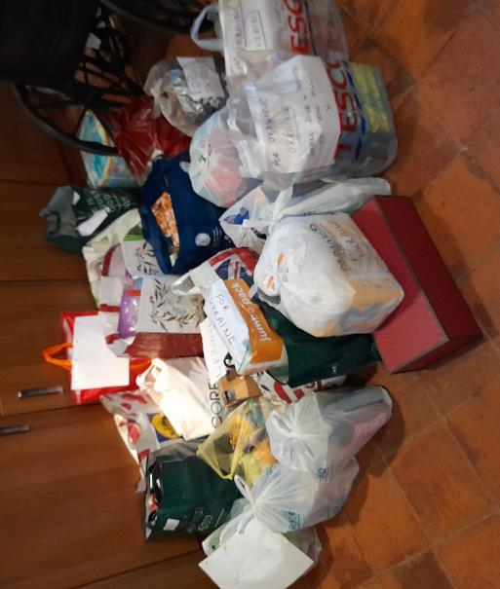
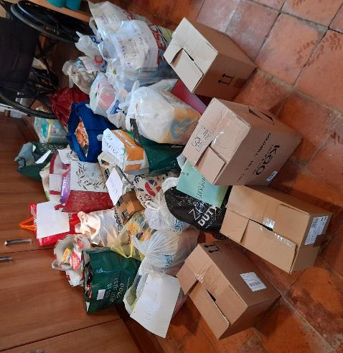
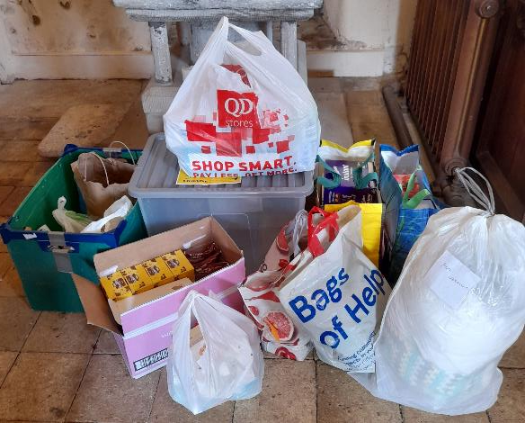
A few of the donations left at All Saints Church from the people of Horsford 2022

Slide 3
Norwich June 2023: Donations for Ukrainian Refugees & aid going to Ukraine
Freight lorries to Ukraine:
Next one to area of flooding from the destroyed Kakhoveka dam
Every Monday, Ukrainian families settling in Norwich can go to “shop” – choose – things for their home
Photos give an idea of what aid is needed…

Slide 4
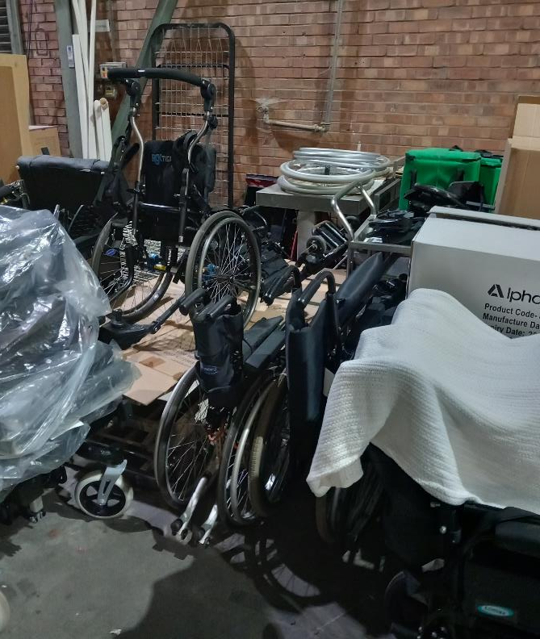
Norwich June 2023: Inside the main warehouse

Slide 5
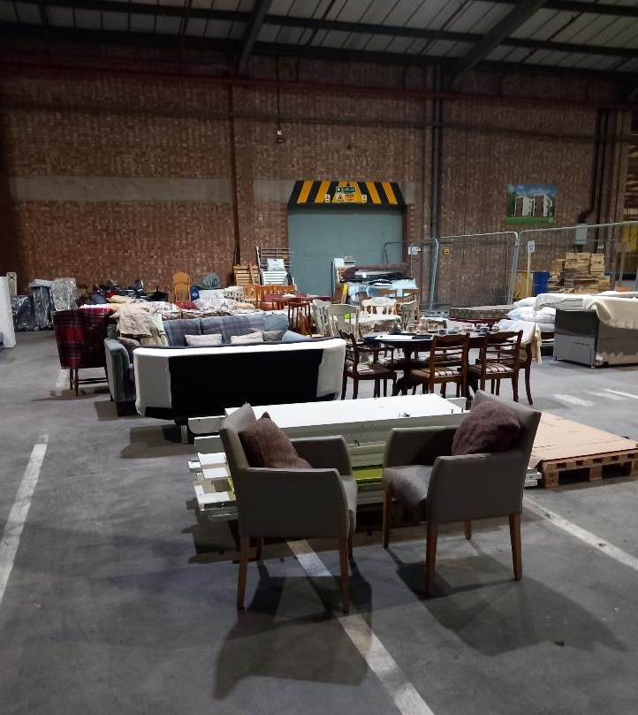
Norwich Warehouse

Slide 6
What the Bible says about Refugees
“When a refugee resides with you in your land, you shall not oppress them. The refugee who resides with you shall be to you as the citizen among you; you shall love the refugee as yourself, for you were refugees in the land of Egypt: I am the Lord your God.”
Leviticus 19:33 & 34
“You shall have one law for the refugee and for the citizen”
Leviticus 24:22
i.e. all people treated the same

